Slide 1

JPMC Data for Good Hackathon
Team 3 - Keya Panchal, Aarini Panzade, Anishka Bompelli,
Fenil Gala, Om Badhe, Harriet Vumiliya
Notes:
aarini

Slide 2
TABLE OF CONTENTS
01
02
03
04
PROBLEM
RESULTS
THE PROCESS
REFLECTION
Notes:
aarini

Slide 3
The Problem
01
Notes:
aarini

Slide 4
Problem Statement
Call to Action
Limitations
Eligibility
Help us identify the top 3 Ohio cities primed for our program.
Unique program that needs cities with both low & high opportunity communities
Household income less than 55% AMI
single or joint parents
must have 1-3 medicaid eligible children
Willing to move to a higher resourced community
Notes:
aarini

Slide 5
Our Results
02
Notes:
keya

Slide 6
Top 3 High-Opportunity Cities
that MTP can move people to
Groveport
Franklin County
Pickerington
Franklin/Fairfield County
Utica
Knox/Licking County
Notes:
Keya

Slide 7
Impact
Working backwards
Use existing infrastructure
By first find high-opp. cities, we are able to prioritize the families future growth and quality of life rather than single out cities based on lack of resources thereof
Due to our model design, resulting cities are near the greater Columbus area but differ in county, allowing MTP to utilize existing infrastructure but also expand their reach
Notes:
keya

Slide 8
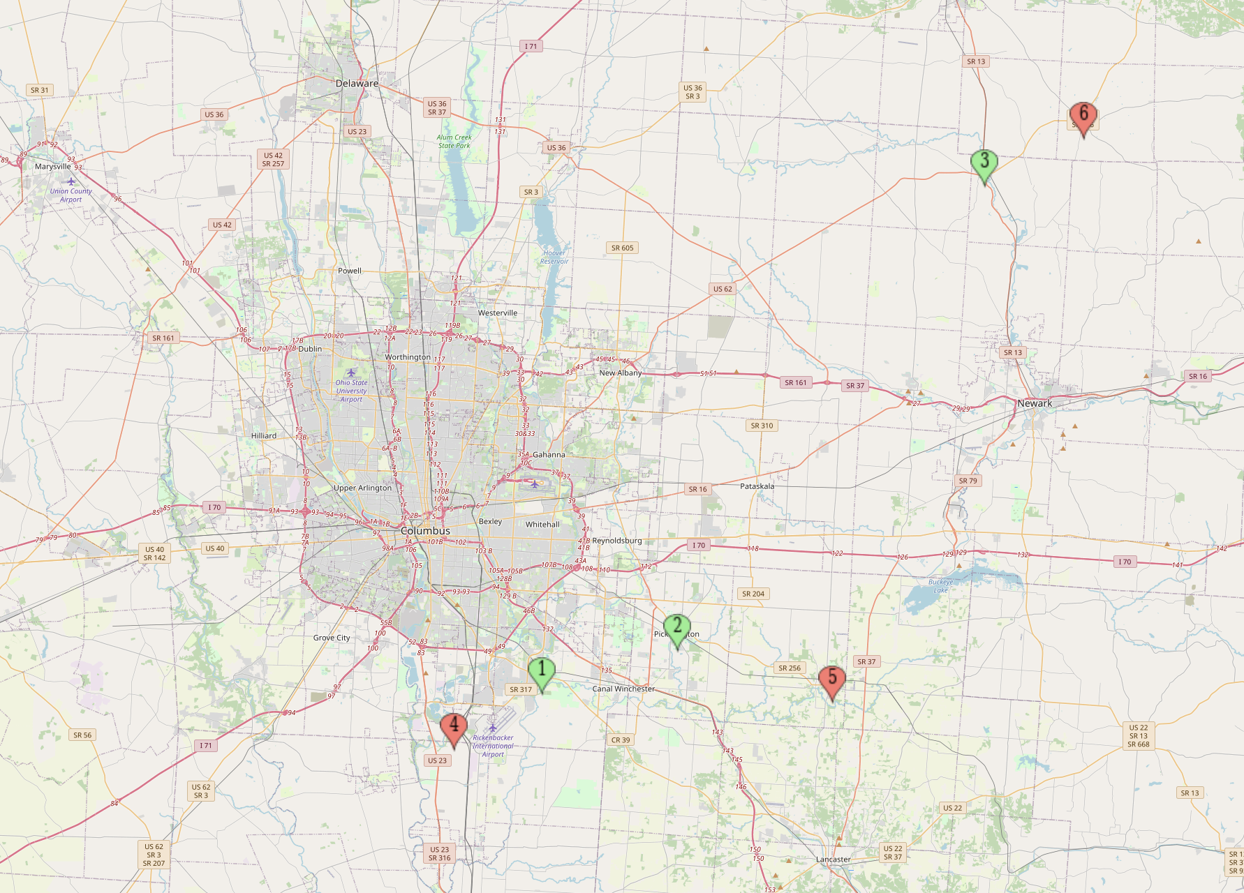
Top 3 Low-Opportunity Cities
for MTP to target:
Lockbourne
Pickaway County
Baltimore
Fairfield County
Martinsburg
Knox County
Notes:
om

Slide 9
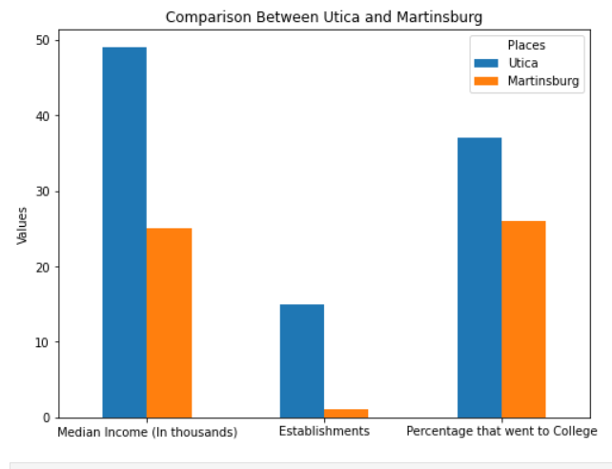
Notes:
om

Slide 10
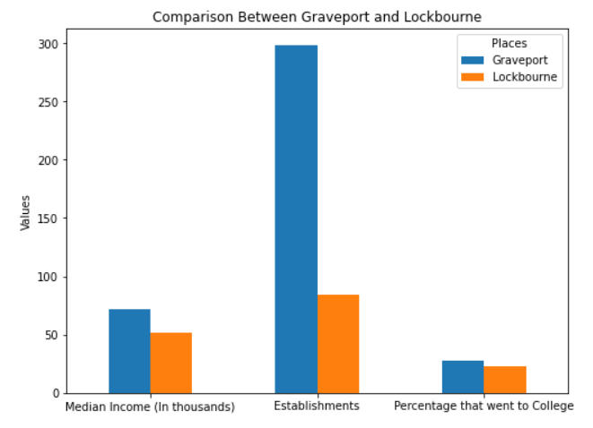
Notes:
om

Slide 11
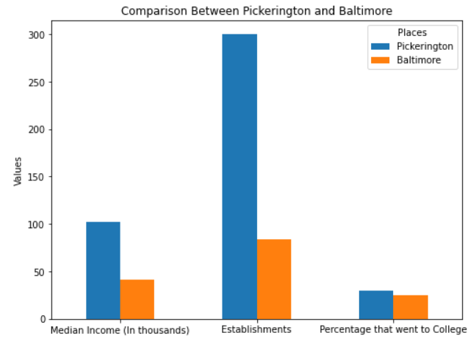
Notes:
om

Slide 12
Our Process
03
Notes:
fenil

Slide 13
Factors (by city)
AMI
Education
Crime Rates
Hospital Count
1P Household
Violent Crime
ETC.
4P Household
Robbery
2P Household
3P Household
DIFFSklPI
DIFFBuildPI
Notes:
fenil

Slide 14
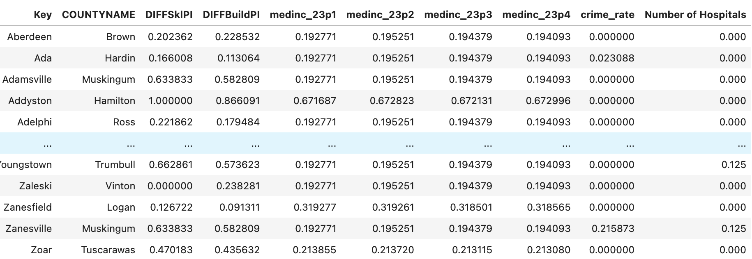
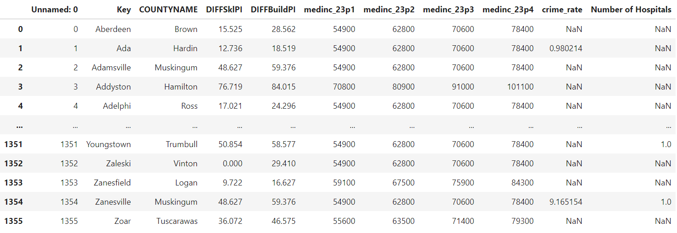
Step 1: Aggregate Data
Merged data sets regarding mentioned factors into one large dataframe
Some cities did not have data, only their county had data
Applied county data to the cities causing some generality
Notes:
fenil

Slide 15
Step 2: Euclidean Distance Data Analysis
Output: 3 cities most similar to the cities MTP has moved families into
Assumption: These cities were considered ideal by MTP
Used Euclidean Distance to determine top 3 high-opportunity cities
Applied weights (i.e. income levels, school performance index) to emphasize certain factors over others (i.e. crime rate)
Found the 3 cities with the smallest distance between themselves and the cities MTP have moved families to
Notes:
anishka

Slide 16
Step 3: Criteria for Finding Surrounding
Low-Opportunity Cities
Proximity
Keep pre-existing relationships and connections that families have to local people and places
Job security
Disparity in resources from high to low-opportunity cities
We want to ensure that the households that need help the most will receive that help
Eligibility
Median income of the city <= 55% AMI
Notes:
anishka

Slide 17
Reflection
04
Notes:
aarini

Slide 18
Reflection
Prioritize families future growth and quality of life
Move people to surrounding counties/cities with greater proximity
Lockbourne
Baltimore
Martinsburg
Groveport
Pickerington
Utica
Notes:
aarini

Slide 19
Thank you!
Any Questions?
Notes:
aarini

Slide 20
Appendix

Slide 21
Euclidean Distance Data Analysis: Cont.
Output: 3 cities most similar to the cities MTP has moved families into (‘served’ cities)
Assumption: the “served” cities were considered ideal by MTP
Used Euclidean Distance to determine top 3 high-opportunity cities
Normalized the data
Applied weights (i.e. income levels, school performance index) to emphasize certain factors over others (i.e. crime rate)
Want to find the difference (Euclidean Distance) between each of the ‘served’ cities and not ‘served’ cities, using these factors
z = (β ₁)(x₁ - y₁) + (β ₂)(x₂ - y₂) + … + (β _{n})(x₂ - y₂)
Found the 3 cities with the smallest Euclidean Distance between themselves and the ‘served’ cities

